Slide 1
The Data of Macroeconomics

Slide 2
GDP, CPI, and Uemployment
Gross Domestic Product (GDP) is the dollar value of all final goods and services produced within an economy in a given period of time.
The consumer price index (CPI) measures the level of prices.
The unemployment rate tells us the fraction of workers who are unemployed.

Slide 3
Gross Domestic Product
Gross Domestic Product is a measure of how well the economy is performing. The Central Statistical Organization (part of the GoI’s Dept. of MOSPI) calculates GDP via administrative data, which are byproducts of government functions such as tax collection, education programs, defense, and regulation, and statistical data, which come from government surveys of, for example, NSSO, ASI, retail establishments manufacturing firms and farm activity.

Slide 4
NATIONAL INCOME
GROSS DOMESTIC PRODUCT (GDP)
It is the value of all final goods and services produced for the marketplace during a given time period within a country's borders.
Key concepts:
  Value: market prices or factor cost
  Final vs intermediate goods
  Value added: Sales receipts less purchase of intermediate goods (avoid double counting)
  Existing versus new (“produced”)
  For the marketplace
  “given time period” Usually annual or quarterly
  “Within a country’s borders” vs “by a country’s nationals”

Slide 5
CALCULATING NI
GNP = GDP + factor payments from abroad-factor payments to abroad
NNP = GNP – Depriciation
NI = NNP – Indirect Business Taxes (or, sales tax)
Personal Income = NI- Social Insurance Contribution – Net Interest + Dividends + Govt Transfers to Individuals + Personal Interest Income
Disposable Income = Personal Income – Personal Tax

Slide 6


Rules for Computing GDP
1) To compute the total value of different goods and services, the national income accounts use market prices.
Thus, if:
$0.50
$1.00
GDP = (Price of apples × Quantity of apples)
+ (Price of oranges × Quantity of oranges)
= ($0.50 × 4) + ($1.00 × 3)
GDP = $5.00
2) Used goods are not included in the calculation of GDP.
3) The treatment of inventories depends on if the goods are stored or
if they spoil. If the goods are stored, their value is included in GDP.
If they spoil, GDP remains unchanged. When the goods are finally sold
out of inventory, they are not counted.

Slide 7
More Rules for Computing GDP
4) Intermediate goods are not counted in GDP– only the value of
final goods. Reason: the value of intermediate goods is already
included in the market price.
Value added of a firm = the value of the firm’s output - the value of the intermediate goods the firm purchases.
5) Some goods are not sold in the marketplace and therefore don’t
have market prices. We must use their imputed value as an estimate
of their value. For example, home ownership and government services.

Slide 8
Real Vs. Nominal GDP
The value of final goods and services measured at current prices is called nominal GDP.
Nominal GDP Y = P × y
This distinction between real and nominal can also be applied to other monetary values, like wages.
This conversion from nominal to real units allows us to eliminate the problems created by having a measuring stick (dollar value) that essentially changes length over time, as the price level changes.

Slide 9
How real GDP is computed in our apple & orange economy?
If we want to compare output in 2009 and output in 2010, we would need base-year prices, i.e. 2009 prices.
Real GDP in 2009 would be:
(2009 Price of Apples × 2009 Quantity of Apples) +
(2009 Price of Oranges × 2009 Quantity of Oranges).
Real GDP in 2010 would be:
(2009 Price of Apples × 2010 Quantity of Apples) +
(2009 Price of Oranges × 2010 Quantity of Oranges).
Real GDP in 2011 would be:
(2009 Price of Apples × 2011 Quantity of Apples) +
(2009 Price of Oranges × 2011 Quantity of Oranges).
Note that 2009 prices are used to compute real GDP for all three years. Because prices are held constant from year to year,
real GDP varies only when the quantities produced vary.

Slide 10
GDP Deflator
THE IMPLICIT PRICE DEFLATOR FOR GDP
GDP Deflator = Nominal GDP
Real GDP
Nominal GDP measures the current dollar value of the output of
the economy.
Real GDP measures output valued at constant prices.
The GDP deflator, also called the implicit price deflator for GDP,
measures the price of output relative to its price in the base year. It
reflects what’s happening to the overall level of prices in the economy.

Slide 11
Chain-Weighted Measures of GDP
In some cases, it is misleading to use base-year prices that prevailed 10 or 20 years ago.
In 1995, the Bureau of Economic Analysis decided to use chain-weighted measures of real GDP. The base year changes continuously over time. This new chain-weighted measure is better than the more traditional measure because it ensures that prices will not be too out of date.

Slide 12
Components of Expenditure
Y = C + I + G + NX
Total demand
for domestic
output (GDP)
Investment
spending by
businesses and
households
is composed
of
Net exports
or net foreign
demand
Consumption
spending by
households
Government
purchases of goods
and services
This is the called the national income accounts identity.

Slide 13
GDP AND ITS COMPONENTS
In 2007, U.S. GDP totaled about 13.8 trillion. This number is incomprehensible. So, if we divide this number by the total population of $302 million, we get GDP per person—the amount of expenditure for the average American– which equaled $45,707 in 2007. Let’s break it down visually on the next slide.

Slide 14
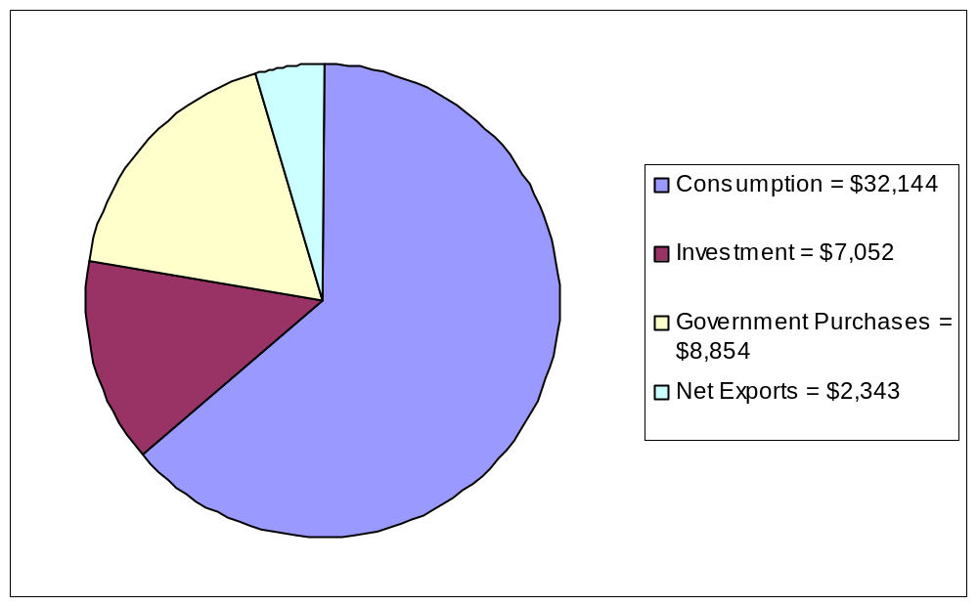
GDP (Y) WAS $45, 707 PER PERSON
Y = C + I + G + NX
$45,707 = $32,144 + $7,052 + $8,854 + $2,343
Note: The numbers above must be multiplied by the U.S. Population 302 million to obtain the totals for the above national income accounts identity Y = C + I + G + NX.

Slide 15
Computing the CPI
The Consumer Price Index (CPI) turns the prices of many goods and services into a single index measuring the overall level of prices.
The Bureau of Labor Statistics weighs different items by computing the price of a basket of goods and services produced by a typical customer. The CPI is the price of this basket of goods relative to the price of the same basket in some base year.

Slide 16
Let’s see how the CPI would be computed in our
apple and orange economy.
For example, suppose that the typical consumer buys 5 apples and 2 oranges every month. Then the basket of goods consists of 5 apples and 2 oranges, and the CPI is:
CPI = ( 5 × Current Price of Apples) + (2 × Current Price of Oranges)
( 5 × 2009 Price of Apples) + (2 × 2009 Price of Oranges)
In this CPI calculation, 2009 is the base year. The index tells how much it costs to buy 5 apples and 2 oranges in the current year relative to how much it cost to buy the same basket of fruit in 2009.

Slide 17

Core Inflation
This statistic measures the increase in the price of a consumer basket that excludes food and energy products. Because food and energy prices exhibit substantial short-run volatility, core inflation is sometimes viewed as a better gauge of ongoing inflation trends.

Slide 18
CPI Versus the GDP Deflator
The GDP deflator measures the prices of all goods produced, whereas the CPI measures prices of only the goods and services bought by consumers. Thus, an increase in the price of goods bought only by firms or the government will show up in the GDP deflator, but not in the CPI.
Also, another difference is that the GDP deflator includes only those goods and services produced domestically. Imported goods are not a part of GDP and therefore don’t show up in the GDP deflator.
The final difference is the way the two aggregate the prices in the economy. The CPI assigns fixed weights to the prices of different goods, whereas the GDP deflator assigns changing weights.

Slide 19
Measuring Unemployment
The labor force is defined as the sum of the employed and unemployed, and the unemployment rate is defined as the percentage of the labor force that is unemployed.
The labor-force participation rate is the percentage of the adult population who are in the labor force.
Unemployment Rate = Number of Unemployed
Labor Force
× 100
Labor-Force Participation Rate = Labor Force
Adult Population
× 100

Slide 20

The Establishment Survey &
The Household Survey
The BLS conducts two surveys of labor market, and therefore produces two measures of total
employment. The establishment survey estimates the number of workers firms have on their payrolls.
The household survey estimates the number of people who say they are working.
Two measures of employment are not necessarily identical, although positively correlated. The reason? The surveys measure different things and the surveys in general, are imperfect.
Some economists believe that the establishment survey is more accurate because it has a larger sample size. Bottom line: all economic statistics are imperfect!

